Slide 1

U.S. Used Car Analysis with Machine Learning Methods
-- Under the guidance of
Dr. Jongwook Woo

Slide 2

Team Members
Jo In, Kang
Parekh, Heta
Ramdas, Priya

Slide 3

Introduction
CarGurus which is based in Cambridge (MA), is an automotive shopping website that assists users in comparing local listings for used and new cars and contacting sellers. Dealers advertise on this site, and CarGurus connect dealers and consumers by putting inventory on the site.
We intend to use several models to identify price and seller rating patterns such as Linear and Ridge Regression, Random Forest, Gradient Boosting and Recommendation which will help the users to take an informative decision before they purchase used car from the Cargurus site.

Slide 4

Dataset Info
DATASET: HTTPS://WWW.KAGGLE.COM/ANANAYMITAL/US-USED-CARS-DATASET
PRODUCTS REVIEWED BETWEEN: 2006 TO 2020 ARE ANALYZED
COUNTRIES CONSIDERED: U.S.A
FILE SIZE: 9.29 GB
NUMBER OF FILES: 1
FILE FORMAT: CSV (COMMA SEPARATED VALUES)
TOTAL NO. OF PRODUCT REVIEWS: 3.0 MILLION
GitHUB Link: https://github.com/Heta-Parekh/MachineLearningModels

Slide 5

H/W Specifications
Hadoop Version: Hadoop 3.2.1-amzn-3.1
Total nodes: 1
Total node memory size: 0-7/ 30874 KB
No. Of CPUs: 8
Total Storage: 481 GB

Slide 6
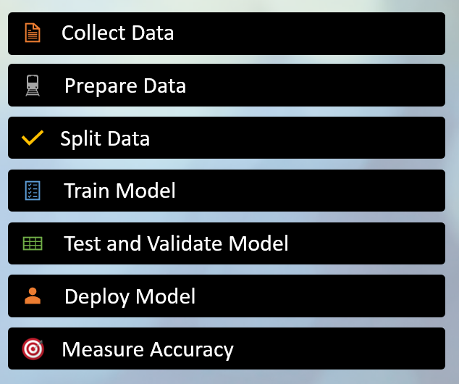
Model Process

Slide 7
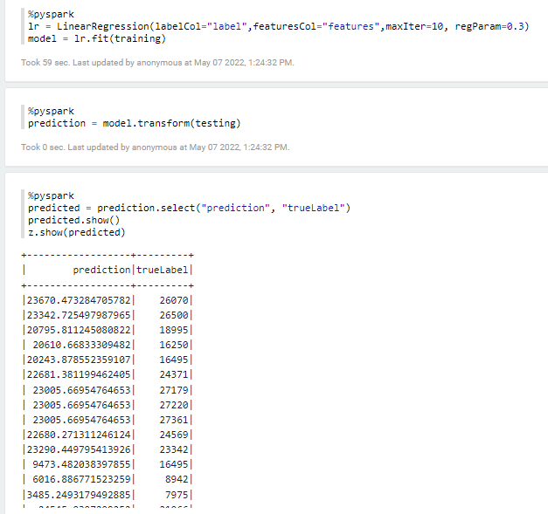
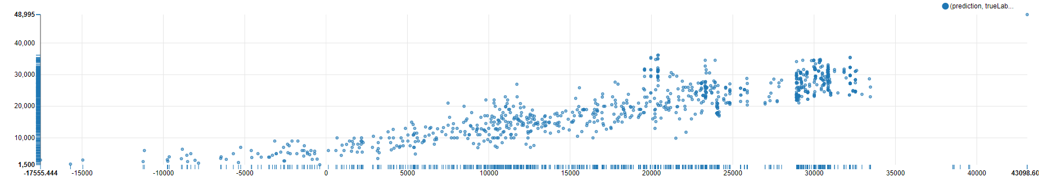
Linear Regression
Coefficient of Determination (R2) : 0.548927
RMSE : 13381.5476

Slide 8
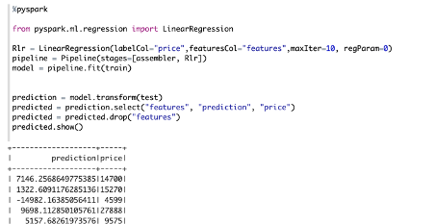
Ridge Regression

Slide 9
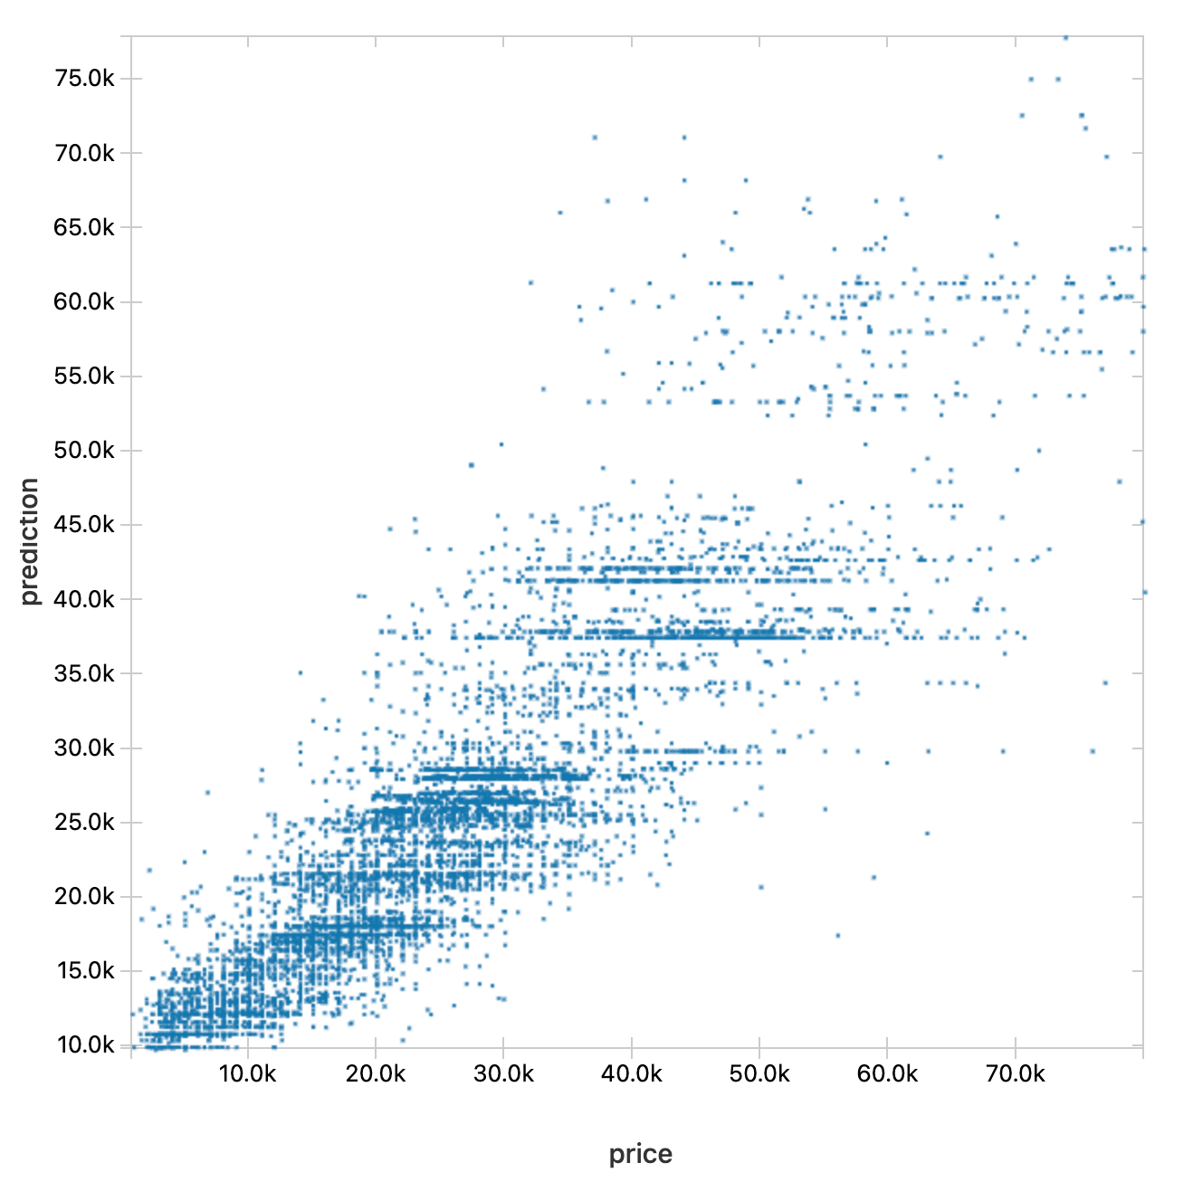
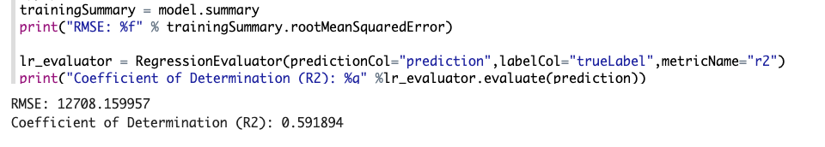
Ridge Regression Cont..

Slide 10
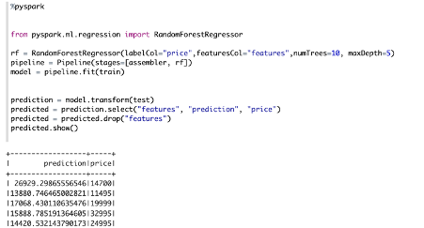
Random Forest

Slide 11
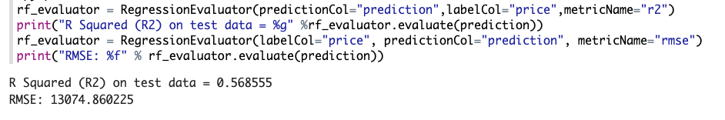
Random Forest Cont..

Slide 12
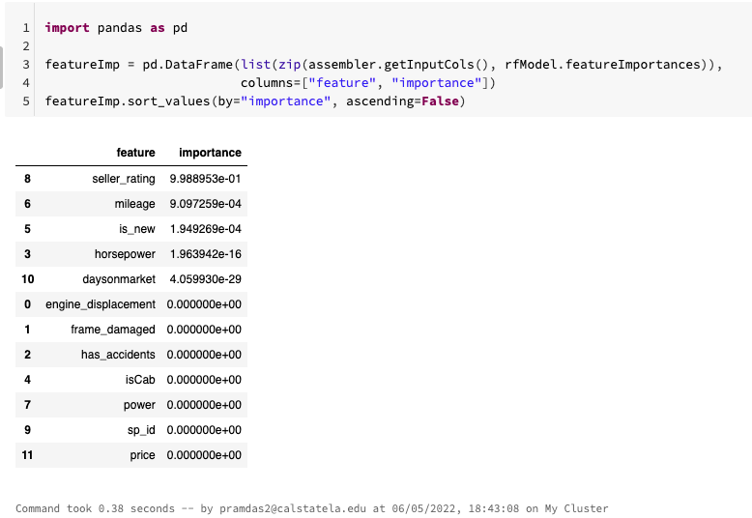
Feature Importance

Slide 13
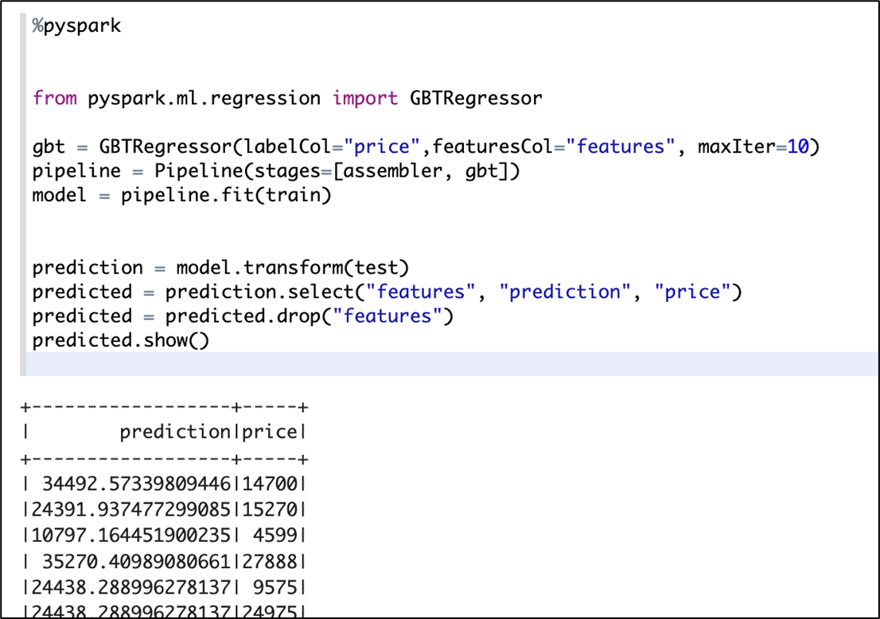
Gradient Boost Tree (GBT)
<Training/Testing at the Zeppelin>

Slide 14
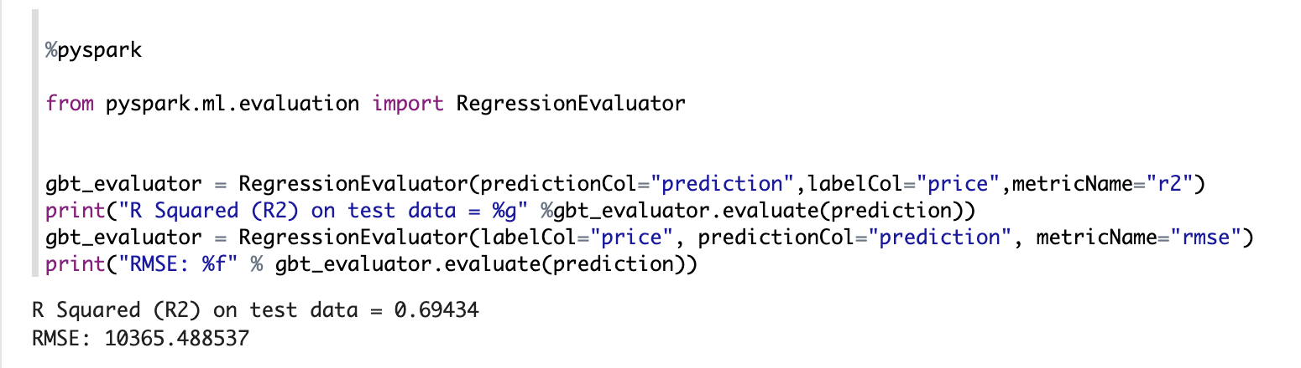
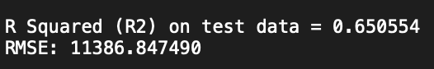
GBT R2/RMSE
<R2/RMSE at the Zeppelin and Pyspark>

Slide 15
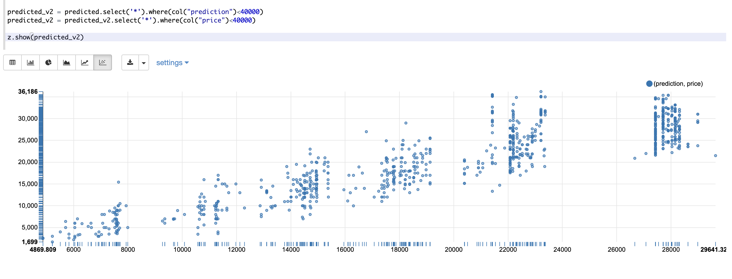
Graph of the GBT model
<Prediction Graph at the Zeppelin (prediction, price) < 40000>

Slide 16
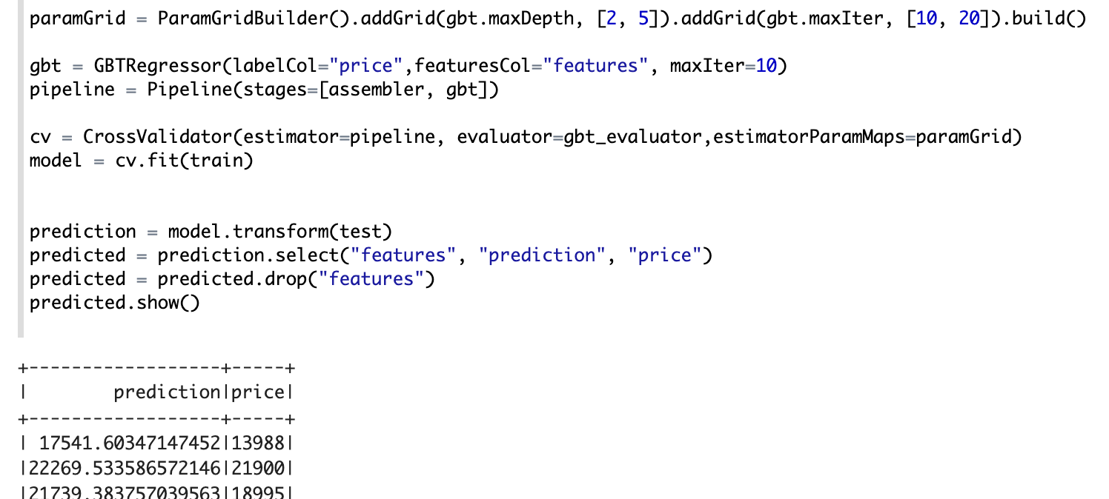
GBT with Cross Validation
<Training/Testing at the Zeppelin>

Slide 17
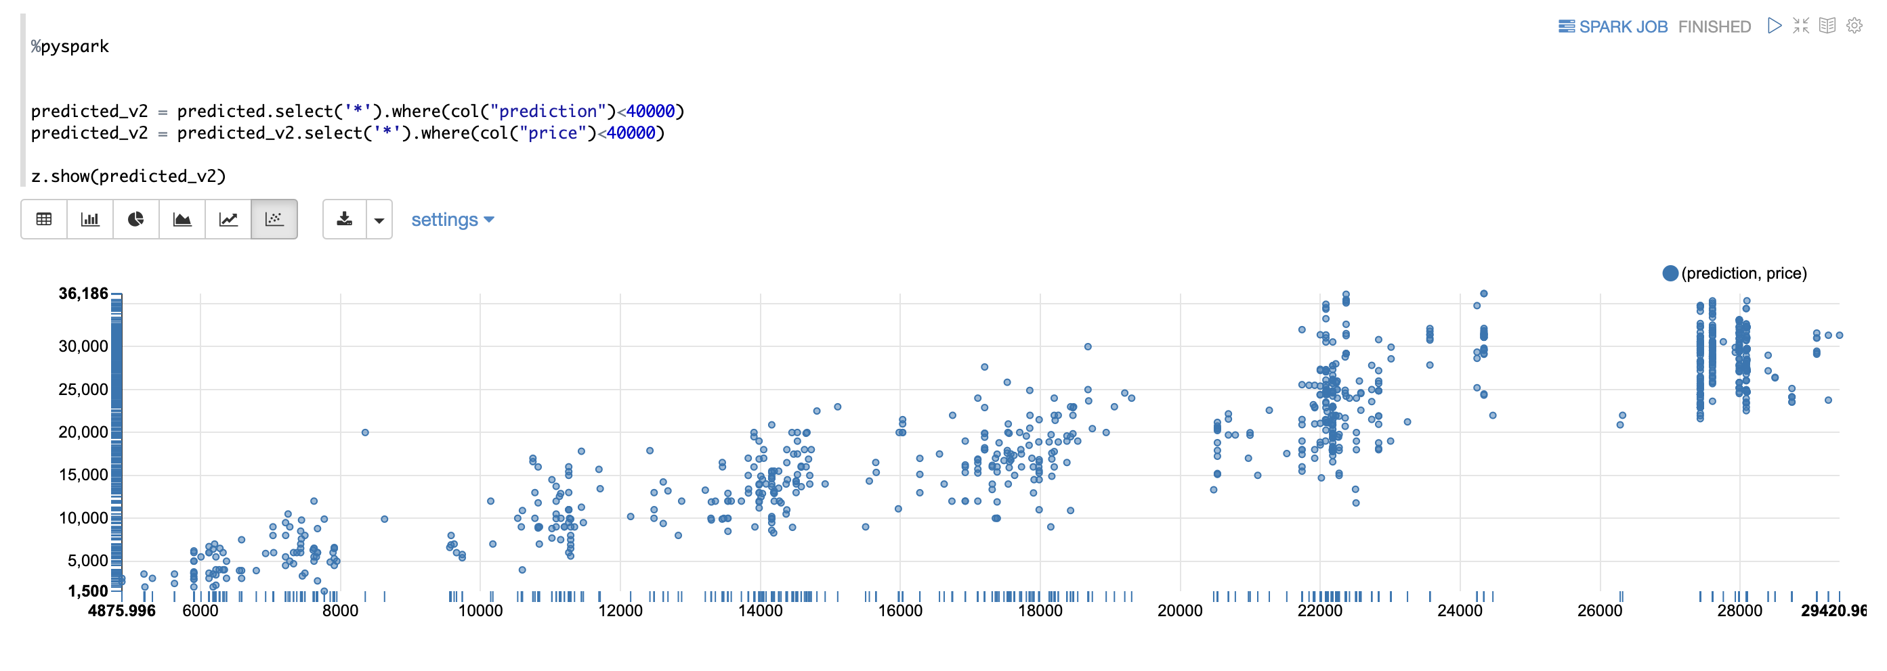
Graph of the GBT with Cross Validation
<Prediction Graph at the Zeppelin (prediction, price) < 40000>

Slide 18
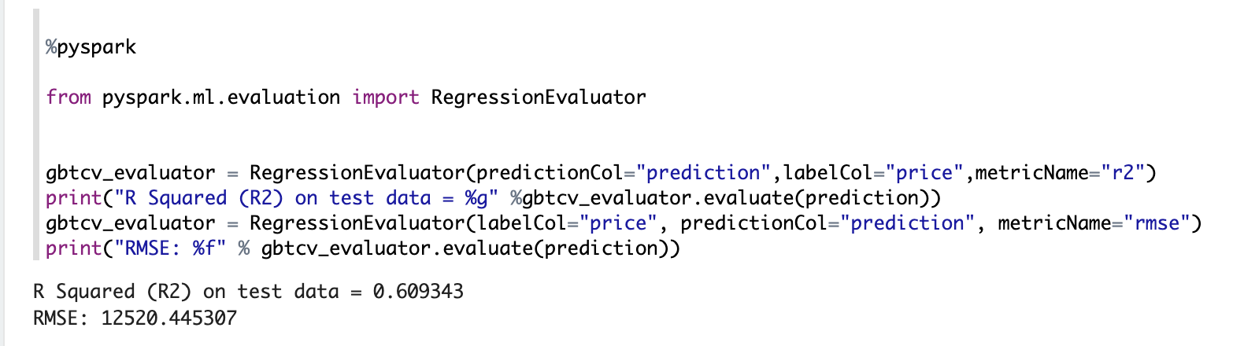
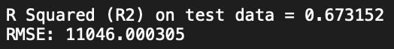
GBT with Cross Validation R2/RMSE
paramGrid = ParamGridBuilder().addGrid(gbt.maxDepth, [2, 5]).addGrid(gbt.maxIter, [10, 20]).build()
cv = CrossValidator(estimator=pipeline, evaluator=gbt_evaluator,estimatorParamMaps=paramGrid)
<R2/RMSE at the Zeppelin and Pyspark>

Slide 19
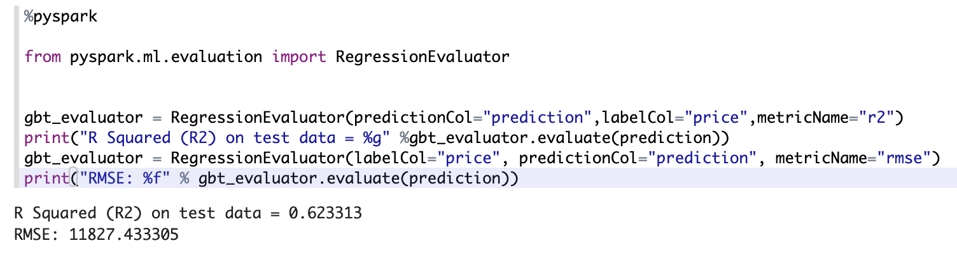
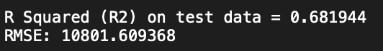
GBT with Train Validation(TV)
paramGrid = ParamGridBuilder().addGrid(gbt.maxDepth, [2, 5]).addGrid(gbt.maxIter, [10, 20]).build()
tv = TrainValidationSplit(estimator=pipeline,evaluator=gbt_evaluator, estimatorParamMaps=paramGrid,trainRatio=0.8)
<R2/RMSE at the Zeppelin and Pyspark>

Slide 20
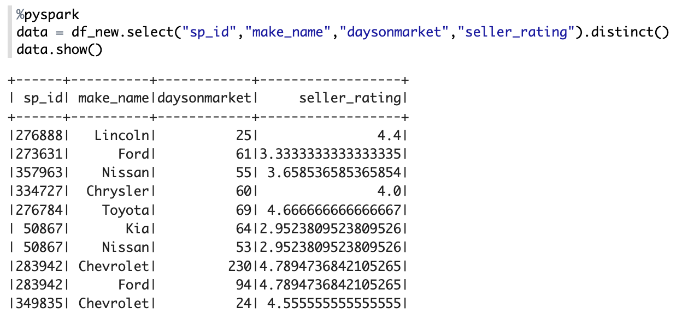
Recommendation Model
< Selecting input data for predicting ”Seller Rating”>

Slide 21
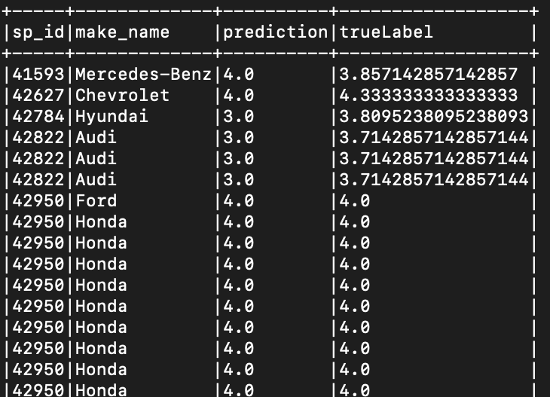
Recommendation Model
<Prediction Result at the Pyspark >

Slide 22
Recommendation Model
<R2/RMSE at the Zeppelin and Pyspark>

Slide 23
Conclusion (Comparing Pyspark Result)
“Price” Prediction model | R2 | RMSE
Linear Regression | 0.54 | 12535
Ridge Regression | 0.56 | 13042
GBT | 0.65 | 11386
GBT /w TV | 0.68 | 10801
GBT /w CV | 0.67 | 11046
Random forest | 0.60 | 12235
“Seller Rating” Prediction model | R2 | RMSE
Recommendation model | 0.69 | 0.44

Slide 24

Thank You

